Slide 1

CDSAML- CCBD Summer 2023
Internship Project - Final Progress update
Project Title : Movement-Inspired Music Recommendation: Leveraging Bidirectional LSTM and GRU Networks
Project Guide : Dr. Priyanka H
Project ID : P27
Project Team :
SRN | NAME | SEMESTER
PES1UG21CS555 | Sharath M S | 4th
PES1UG21CS254 | K Prajwal Rai | 4th
PES1UG21CS290 | Kriti Sujeeth | 4th
PES1UG20CS608 | Tushar N Borkade | 6th

Slide 2
Music Recommendation Based on Human Motion
Outline
Problem Statement
Scope and Feasibility study
Applications/Use cases
Data Processing Tools
Selection of Dance Forms
Data Collection and Preparation
Audio waveforms
Project Development Journey
Dance form prediction
Explanation of the various models used
Recommending Music
Milestones
References

Slide 3
Music Recommendation Based on Human Motion
Problem Statement
Our project aims to develop a music recommendation system based on human motion or dance style. By analyzing the skeletal points coordinates and video of a dancer, along with synced music, we can recommend music that matches the dance style used. The input data includes the coordinates of skeletal points, a video showing the dancer's movements, and pre-synced music.
The system will preprocess the data to align the music and analyze the dance style based on motion patterns and body movements. Using a database of music tracks categorized by dance styles, the system will recommend music that is suitable for the identified dance style.
The user will be presented with the recommended music tracks, allowing them to preview and select the desired music for their dance. Through this system, dancers can discover music that enhances their dance style and creates a more immersive dance experience.

Slide 4
Music Recommendation Based on Human Motion
Scope and Feasibility study
The system's scope encompasses dancers, choreographers, and dance enthusiasts across various dance styles and skill levels.
It can be utilized for practice, performances, competitions, and personal enjoyment.
A curated music database categorized by dance styles is essential for effective music recommendations. Efficient processing and a user-friendly interface contribute to the system's feasibility.
Continuous updates and user feedback will enhance the system's performance, making it a valuable tool for dance enthusiasts worldwide.

Slide 5
Music Recommendation Based on Human Motion
Scope and Feasibility study
Ambiguity in Dance Style Recognition: Dance styles can sometimes exhibit overlapping characteristics or variations, making it challenging to accurately classify and categorize them based solely on skeletal points.
Subjectivity of Dance Styles: Dance styles can be subjective and open to interpretation, making it difficult to define strict boundaries or rules for categorization.
May face a challenge because we are using mediapipe and not Openpose while trying to train the machine learning model.

Slide 6
Music Recommendation Based on Human Motion
Literature Review
Name | Author | Published Year | Summary
Robust Intelligent Posture Estimation for an AI Gym Trainer using Mediapipe and OpenCV | Venkata Sai P Bhamidipati,Ishi Saxena, Mrs. D. Saisanthiya, Dr. Mervin Retnadhas | 2023 | Features of Mediapipe and OpenCV that help in extracting pose data from videos.

Slide 7
Music Recommendation Based on Human Motion
Literature Review
Name | Author | Published Year | Summary | Model/Algorithm
Music Recommendation Based on Feature Similarity | Huihui Han,Xin Luo,Tao Yang ,Youqun Shi | 2018 | Using MFCC for feature extraction, music recommendations are made based on similarity between audio tracks. | Mel Frequency Cepstral Coefficient

Slide 8
Music Recommendation Based on Human Motion
Literature Review
Name | Author | Published Year | Summary | Model/Algorithm
Music-Driven Dance Generation | Yu Qi, Yazhou Liu and Quansen Suni | 15 November 2019 | Attention mechanism refers to the process of focusing on importing information while filtering out unnecessary data. After integrating the attention mechanism the network will retain all states from the encoder and assign a weighted average to the encoder state of each element in the decoder sequence. The Decoder network has a structure similar to that of the encoder network. It comprised of an attention layer, three LSTM layers, and a dense layer, in order of the data flow. | LSTM-Self Attention

Slide 9

Music Recommendation Based on Human Motion
Literature Review
Name | Author | Published Year | Summary | Model
Learn2Dance: Learning Statistical Music-to-Dance Mappings for Choreography Synthesis | Ferda Ofli, Engin Erzin, Yücel Yemez and A. Murat Tekalp | 3 June 2012 | The core of the choreography synthesis is defined as a Viterbi decoding process on a discrete HMM, which is constructed by the musical measure models and the figure transition model,. The exchangeable figures model is utilized to introduce acceptable variations into the Viterbi decoding process to enrich the synthesized choreography. | Viterbi decoding process on a discrete hidden Markov models (HMMs)

Slide 10
Music Recommendation Based on Human Motion
Literature Review
Name | Author | Published Year | Summary | Model
Music similarity-based approach to generating dance motion sequence | Minho Lee·Kyogu Lee·Jaeheung Park | 28 November 2012 | A new piece of music is segmented automatically according to significant changes denoted by an audio novelty function. Each music, the system will choose the cluster of music segments that is most similar to the input music segment. The best motion is selected and is synchronized with input music segment using cross-correlation between the input music segment and the chosen motion segment. | K Means Clustering

Slide 11
Music Recommendation Based on Human Motion
Literature Review
Name | Author | Published Year | Summary | Model
Music Recommendation based on facial expression by using deep learning | S.Sunita, V.Jyothi,P.Ramya,S.Priyanka | January-2023 | A model which recognizes emotions and recommends music based on that | using mediapipe,DNN and CNN

Slide 12
Music Recommendation Based on Human Motion
Literature Review
Name | Author | Published Year | Summary | Model
Automatic Composition Software for Three Genres of dance Using 3D Motion Data | Bin Umino, Dr. Asako Soga | 2009 | creating dance moves based on whats already given | Analytic-synthetic choreography and transition diagrams

Slide 13
Music Recommendation Based on Human Motion
Literature Review
Name | Author | Published Year | Summary | Model
Dance Posture Recognition using wide-baseline orthogonal stereo cameras. | Feng Guo and Gang Qian | 2006 | A robust posture recognition system using two wide-baseline orthogonal video cameras is proposed in this paper. GMM (Gaussian Mixture Model) and KLD (Kullback- Leibler Divergence) are used to represent posture silhouettes extracted from two views and to measure silhouettes distances. | GMM (Gaussian mixture model) KLD (kullback- Leibler divergence) RVM (Relevance Vector Machine, for pose recognition)

Slide 14
Music Recommendation Based on Human Motion
Literature Review
Name | Author | Published Year | Summary | Model
Content- based Music Recommendation System | Aldiyar Niyazov, Elena Mikhailova,, Olga Egorova | 2021 | This model is based on solely on the music characteristics. They use a method based on the extraction and further analysis of acoustic characteristics of the audio signals. The results significantly outperformed random recommendations. | ANN (Artificial Neural Network) ReLU activation function.

Slide 15
Music Recommendation Based on Human Motion
Literature Review
Name | Author | Published Year | Summary | Model
Query-by-Dancing: A dance music retrieval system based on body motion similarity | Shuhei Tsuchida, Satoru Fukayama, Masataka Goto | 2018 | Retrieves a musical piece using dance motions. This system’s retrieval method is appropriate for dance music, that the system can find musical pieces that are easy to dance and that better music can be obtained by weighting the importance of dance motions. | weighted retrieval methods and similarity measures.

Slide 16
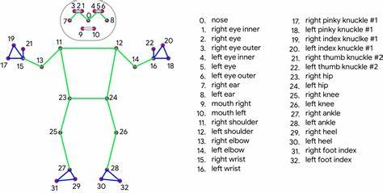
Music Recommendation Based on Human Motion
Data Processing Tools
At the onset of our project, we recognized the need to convert dance videos into skeletal data and collect corresponding audio for accurate dance form prediction. After extensive research, we selected two key software tools:
1. Mediapipe for Skeletal Data:
Mediapipe proved to be the optimal solution for converting dance videos into skeletal data. This software utilizes advanced computer vision techniques to extract 33 key skeletal points from each frame of the dance video. These skeletal points represent essential body landmarks and movements, providing valuable data for our prediction models. Mediapipe's accuracy and efficiency, combined with its free availability, made it the ideal choice for this crucial data transformation process.

Slide 17
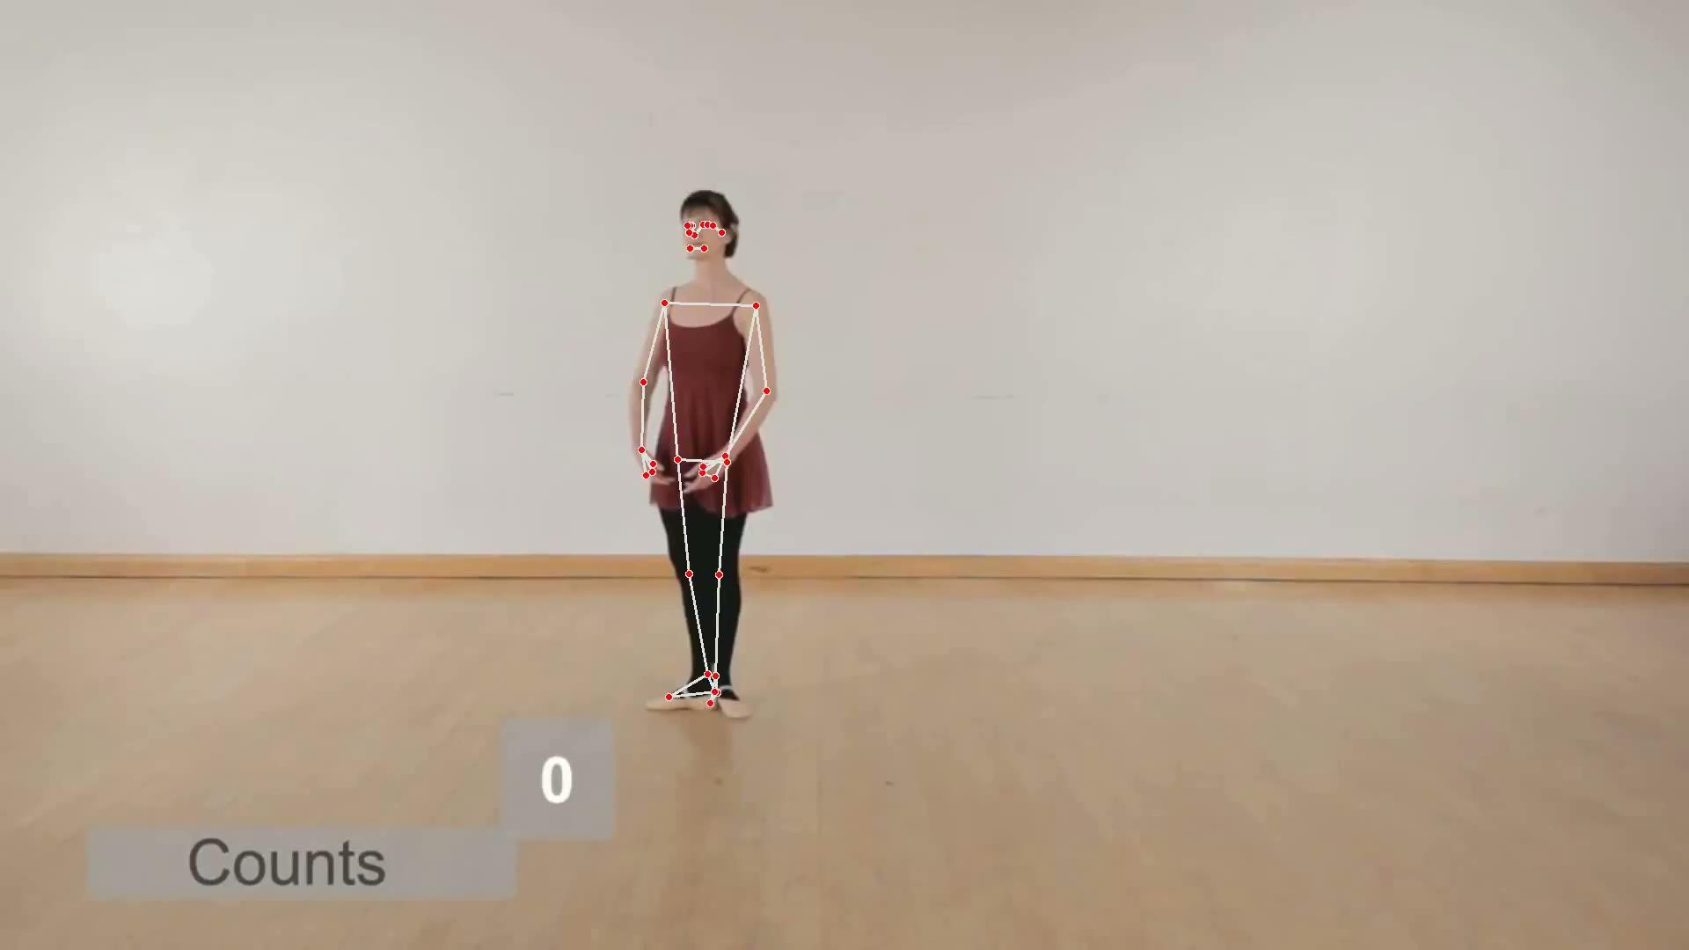
Music Recommendation Based on Human Motion
Data Processing Tools

Slide 18
Music Recommendation Based on Human Motion
Data Processing Tools
2. Ffmpeg for Audio Extraction:
To gather the corresponding audio data from dance videos, we employed Ffmpeg. Ffmpeg is a powerful and versatile multimedia framework that enables us to extract audio streams from the dance video files. This tool ensures that we have synchronized audio data with the extracted skeletal information, facilitating comprehensive analysis and prediction.
By utilizing Mediapipe and Ffmpeg in our data preparation pipeline, we set a strong foundation for building effective dance prediction and music recommendation models. These software choices not only offer accuracy and efficiency but also align perfectly with our project's goal of creating an intelligent and robust dance and music exploration platform.

Slide 19
Music Recommendation Based on Human Motion
Selection of Dance Forms
In our project, we carefully considered a wide range of dance forms to work with, including those of Indian origin. However, after thorough evaluation, we made a strategic decision to focus on ballet, hip-hop, contemporary, salsa, and tap dance forms.
The choice of these dance forms was based on their suitability for our data processing pipeline. By selecting ballet, hip-hop, contemporary, salsa, and tap, we ensured that the software could accurately identify the skeletal points and convert them into pose data. This approach was vital to maintain the precision and reliability of our dance prediction models.
While we appreciate the richness of Indian dance forms, the selection of these five dance styles allowed us to streamline our project's data processing and analysis, resulting in more accurate and efficient predictions. Our aim is to deliver a top-notch dance and music exploration experience, and this selection aligns perfectly with that objective.

Slide 20
Music Recommendation Based on Human Motion
Data Collection and Preparation
As a team, we each contributed to collecting dance videos of various styles, resulting in a diverse dataset comprising approximately 25 videos. Each video, with an average of 38 frames per second, required careful processing to ensure only essential information was retained, while eliminating unnecessary footage.
Using the software tools, Mediapipe and Ffmpeg, as previously mentioned, we efficiently generated skeletal datasets for all five dance forms: ballet, hip-hop, contemporary, salsa, and tap. Additionally, we extracted the corresponding audio from each video. To organize the data for future model training, we meticulously stored the datasets and audio files in their respective directories.
By streamlining the data collection and preparation process, we have set the groundwork for training our dance prediction and music recommendation models. The combination of diverse dance forms and synchronized audio data will allow our models to learn effectively and provide accurate predictions for a more immersive dance and music experience.

Slide 21
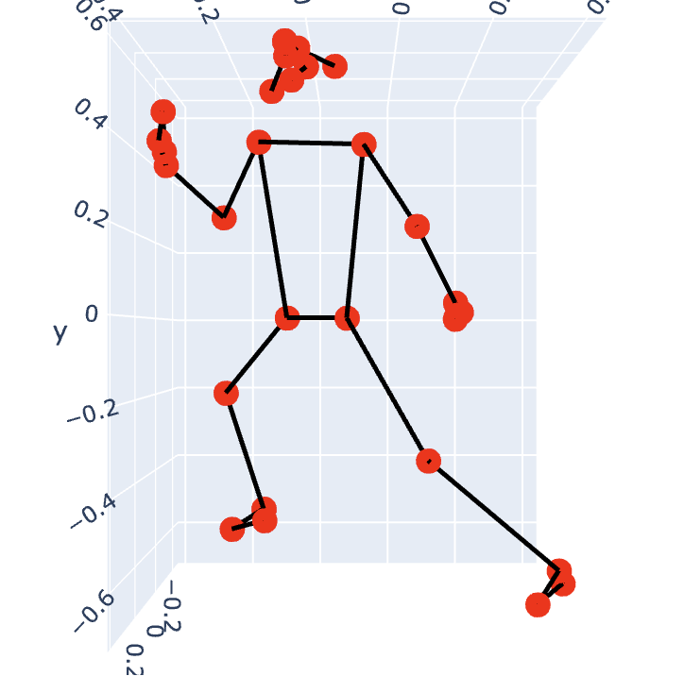
Music Recommendation Based on Human Motion
Preprocessing
1. Loading Pose Data from JSON files:
● The code reads JSON files containing pose data (coordinates of body keypoints) from the pose_root directory. Each JSON file contains a sequence of pose frames, where each frame represents the coordinates of body keypoints at a specific time.

Slide 22
Music Recommendation Based on Human Motion
Preprocessing
2. Extracting Features from Pose Data:
● For each pose sequence, the code extracts two types of features: distances between keypoint pairs and angles between certain keypoint vectors.
- Distances between Keypoint Pairs: The Euclidean distance between two keypoints is calculated for a predefined set of keypoints. In this case, distances are calculated for pairs of keypoints, where each pair represents a specific body part or limb.
- Angles between Keypoint Vectors: The code calculates the angle between vectors formed by connecting three key points. Specifically, the angles between vectors (v1 and v2) are computed as arccosine of the dot product of v1 and v2 divided by the product of their magnitudes.
● After computing distances and angles for each frame in a pose sequence, the mean of these features is taken across all frames to obtain pose_features_mean, which serves as a representative feature vector for the entire pose sequence.

Slide 23
Music Recommendation Based on Human Motion
Preprocessing
3. Loading Corresponding Audio Files:
● The code loads the corresponding audio files (.wav) from the audio_root directory. Each audio file corresponds to a pose sequence (JSON file) and contains the audio signal for the dance routine associated with that pose sequence.
4. Computing Audio Spectrogram:
● The audio signal is transformed into a spectrogram using Mel-frequency cepstral coefficients (MFCCs). A spectrogram is a visual representation of the spectrum of frequencies of a signal as it varies with time. MFCCs are widely used in audio processing tasks as they capture important characteristics of audio signals.
5. Computing Mean of Audio Spectrogram:
● The computed spectrogram is converted to a logarithmic scale (log_spectrogram) to enhance the representation of audio features. The mean of the log-spectrogram is then calculated across the time axis to obtain log_spectrogram_mean, representing the average audio features for the entire audio signal.

Slide 24
Music Recommendation Based on Human Motion
Preprocessing
6. Concatenating Pose and Audio Features:
● The feature vectors pose_features_mean and log_spectrogram_mean are concatenated to form the final feature vector for each sample. This combined feature vector contains both pose and audio information, capturing the key characteristics of the dance routine.
7. Data and Label Preparation:
● The computed feature vectors are collected in the data list, and the corresponding labels (representing dance types) are collected in the labels list. Finally, these lists are converted to numpy arrays, and the data is reshaped to have the shape (num_samples, num_features, 1) to be compatible with the model.
The preprocessing steps described above aim to create a feature set that captures relevant information from both the pose data and audio signals. By combining these features, the model can learn to represent and differentiate between different dance types effectively.

Slide 25
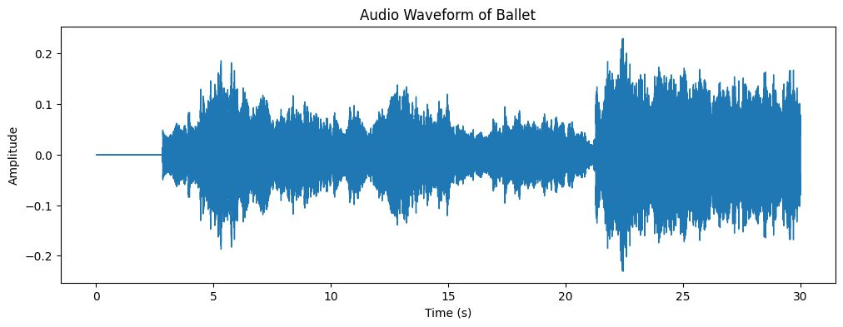
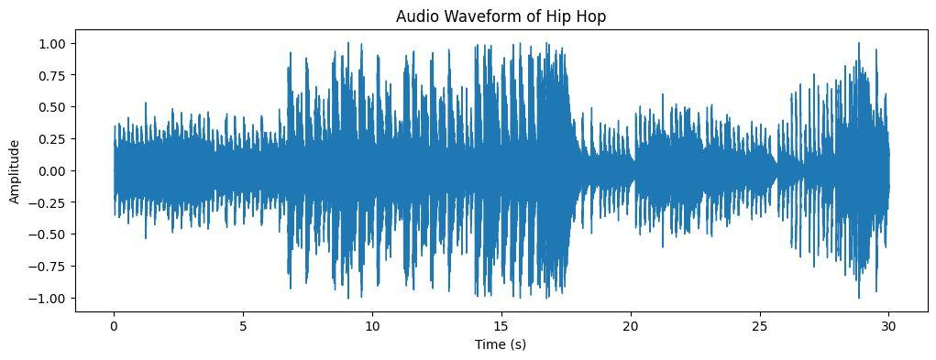
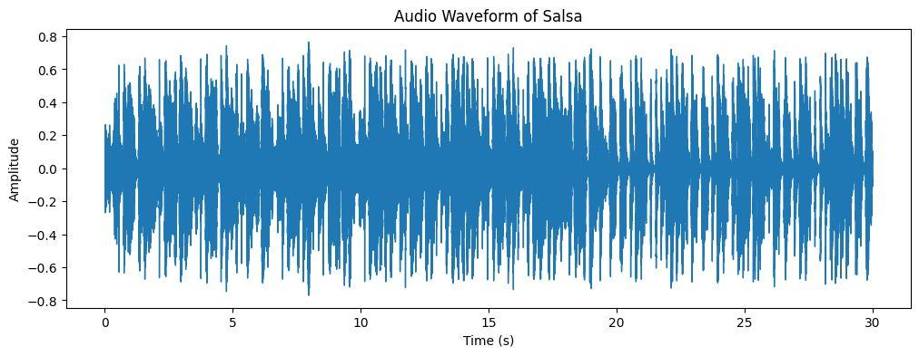
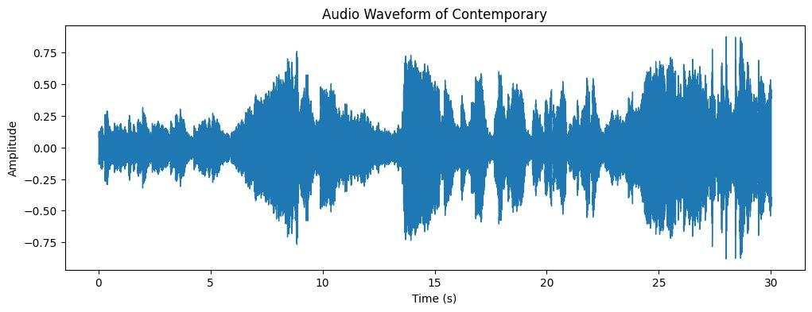
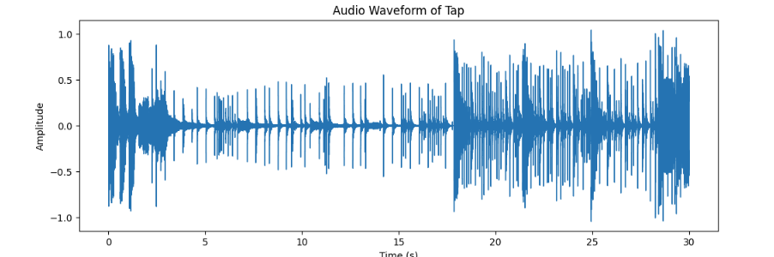
Music Recommendation Based on Human Motion
Audio waveforms

Slide 26
Music Recommendation Based on Human Motion
Audio waveforms
Selecting dance forms based on audio waveforms involves using the visual representation of sound waves to identify patterns or characteristics that are unique to each dance form.
Amplitude and Intensity: Dance forms often have distinct rhythms and movements, which are reflected in the amplitude and intensity of the audio waveform. Different dance forms may have varying levels of loudness or softness, resulting in differences in the waveform vertical height and overall shape.
Tempo and Beats: The tempo and beats of a dance form influence the periodicity and regularity of the audio waveform. Faster dance forms like hip-hop may exhibit more rapid and consistent wave patterns, while slower dance forms like ballet may show more spaced-out and elongated waves.
Silence and Rests: Silent or resting moments during a dance performance are also reflected in the audio waveform. These pauses may create gaps or flat lines in the waveform, contributing to the overall pattern of the dance form.

Slide 27
Music Recommendation Based on Human Motion
Audio waveforms
Frequency Spectrum: Different dance forms may be accompanied by specific musical instruments or sound characteristics, resulting in variations in the frequency spectrum of the audio waveform. For instance, salsa may have prominent percussion sounds, whereas contemporary dance may have a broader range of frequencies due to diverse music choices.
Timbre and Sound Quality: Timbre refers to the unique quality of a sound produced by different instruments or vocal characteristics. Dance forms with distinct music styles may exhibit specific timbre patterns, which can be visualized in the audio waveform.

Slide 28
Music Recommendation Based on Human Motion
Project Development Journey
1. Research and Learning Phase: After receiving Post Review 1 feedback, the entire team devoted a week to learning and researching the best possible model to enhance our project.
2. Initial Model Building Attempts: The subsequent week was dedicated to building a model for music recommendation. However, despite repeated efforts, we encountered challenges and faced failures.
3. Pivotal Decision: Recognizing the complexity of directly recommending music to users, we made a strategic decision to introduce an intermediate step. The focus shifted to developing a model capable of accurately predicting the dance form in the input video.
This pivotal shift in our approach proved to be a turning point in the project, providing us with a clearer direction and a more achievable goal. By incorporating an intermediate dance prediction model, we laid the foundation for a more robust and effective system that aligns with our ultimate objectives.

Slide 29
Music Recommendation Based on Human Motion
Dance form prediction
In our quest to predict the dance form, we explored various model architectures, including:
1. LSTM (Long Short-Term Memory)
2. LSTM-GRU (Long Short-Term Memory - Gated Recurrent Unit)
3. Bidirectional GRU-Bidirectional LSTM
4. Bidirectional GRU-LSTM
5. Sequence-to-Sequence
Each of these models was meticulously designed with the primary objective of accurately predicting the dance form based on the provided input datasets. This comprehensive approach allowed us to explore different neural network architectures and identify the most suitable one for our specific task.

Slide 30
Music Recommendation Based on Human Motion
What is LSTM
Long Short-Term Memory (LSTM) is a type of recurrent neural network (RNN) architecture that was designed to model temporal sequences and their long-range dependencies more accurately than conventional RNNs.
An LSTM cell consists of three gates (input, forget, and output) and a cell state.
The input gate determines how much of the incoming information should be stored in the cell state.
The forget gate determines how much of the current cell state should be discarded.
The output gate determines how much of the current cell state should be exposed to the next layers in the network.
The cell state can store long-term dependencies that are regulated by the input and forget gates.

Slide 31
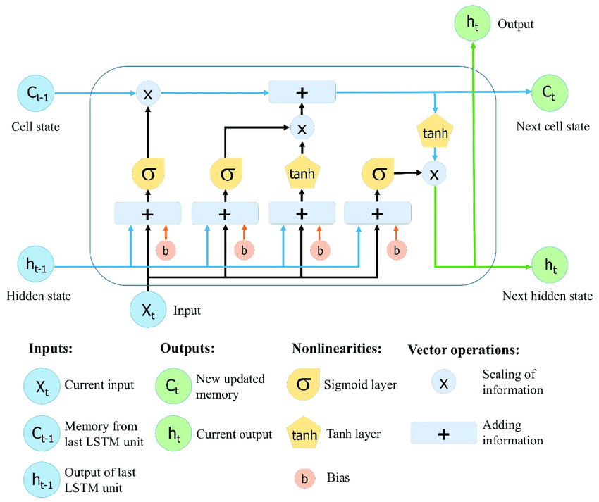
Music Recommendation Based on Human Motion
What is LSTM

Slide 32
Music Recommendation Based on Human Motion
LSTM
For dance form prediction, we designed a deep learning model with the following architecture:
1. Convolutional Layers: Two Conv1D layers with 256 filters and a kernel size of 3 were applied. Leaky ReLU activation with an alpha of 0.2 followed each convolutional layer, adding non-linearity to the model.
2. Max Pooling and Dropout: MaxPooling1D with a pool size of 2 was used to downsample the data, followed by a dropout layer with a rate of 0.3, aiding in preventing overfitting.
3. LSTM: The first LSTM layer with 256 units had return sequences set to True, allowing it to pass sequences to the next layer.

Slide 33
Music Recommendation Based on Human Motion
LSTM
4. Dense Layers: Dense layers were introduced to learn higher-level features. A Dense layer with 256 units followed by Leaky ReLU activation (alpha=0.2) and a dropout layer with a rate of 0.3.
5. Output Layer: The final Dense layer with a softmax activation function produced predictions for the 5 dance types.
Model Compilation and Training:
The model was compiled with sparse categorical cross-entropy as the loss function, Adam optimizer with a learning rate of 0.001, and accuracy as the evaluation metric.
The model was trained on the dataset for 200 epochs, using X_train and y_train for training, and X_validation and y_validation for validation.

Slide 34
Music Recommendation Based on Human Motion
LSTM
This architecture is tailored to leverage temporal patterns in dance sequences and aims to predict the dance form accurately. By incorporating various layers and techniques, we expect our model to achieve high accuracy in dance form prediction.

Slide 35
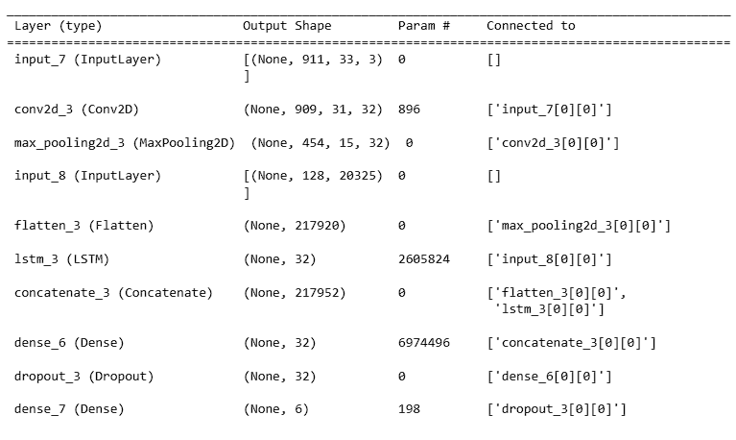
Music Recommendation Based on Human Motion
LSTM Model Summary

Slide 36
Music Recommendation Based on Human Motion
What is LSTM-AE
LSTM Autoencoder (LSTM-AE) is a special type of LSTM network designed for the task of representation learning, specifically for encoding sequential data into a fixed-length vector, and then reconstructing (decoding) the original sequence from this representation.
It's composed of two main components:
Encoder: The first part of the network (the encoder) takes the input sequences and encodes them into a fixed-length "context vector". The encoder processes the input sequence and compresses the information into the context vector. This context vector is then used as a summary of the input sequence, holding learned information of the input sequence.
Decoder: The second part of the network (the decoder) takes the context vector and unfolds it into the original input sequence. Essentially, it's trying to recreate the original input sequence from the compressed context vector.

Slide 37
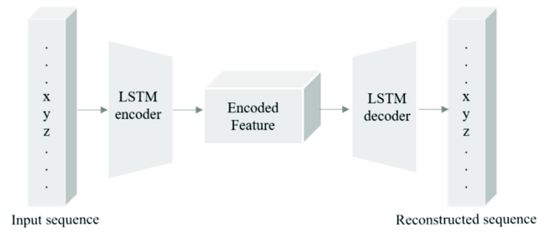
Music Recommendation Based on Human Motion
What is LSTM-AE

Slide 38
Music Recommendation Based on Human Motion
LSTM-AE
We have developed a multimodal dance prediction model that combines video pose data and audio features to predict dance forms. The model architecture consists of LSTM layers for encoding and decoding, enabling effective learning and sequence-to-sequence predictions.
Key Model Features:
1. Input Data Preparation: The video pose data is reshaped to match the expected shape of (911, 33*3), while the audio data is prepared with a shape of (128, 17183).
2. LSTM Encoder: We employ an LSTM layer with 32 units and L2 regularization to encode the video pose data.

Slide 39
Music Recommendation Based on Human Motion
LSTM-AE
3. LSTM Decoder: The model uses another LSTM layer with 32 units, L2 regularization, and return_sequences=True to decode the audio data. The encoder output is provided as the initial state for the decoder.
4. Output Layer: The decoder output is fed into a Dense layer with the softmax activation function to predict dance form classes (num_classes).
5. Model Compilation: We compile the model using the Adam optimizer and categorical cross-entropy loss function to facilitate training.
6. Data Preparation and Splitting: The onehot_encoded target data is reshaped to match the output tensor's shape. The data is shuffled, and the pose data is further reshaped to match the expected input shape. The dataset is then split into 80% training and 20% testing sets.

Slide 40
Music Recommendation Based on Human Motion
LSTM-AE
7. Model Training: We train the model using the training data (X_train_pose, X_train_audio) and target data (y_train) for 100 epochs, with a batch size of 8 and a validation split of 20%.
8. Model Evaluation: Finally, we evaluate the model's performance on the testing data (X_test_pose, X_test_audio) and target data (y_test).
This multimodal approach leverages both video pose data and audio features to enhance the dance prediction accuracy, offering a comprehensive and promising solution for dance form recognition in diverse and dynamic dance performances.

Slide 41
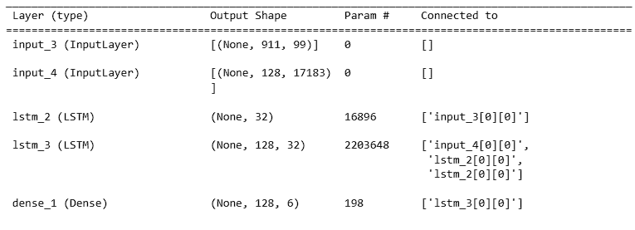
Music Recommendation Based on Human Motion
LSTM-AE

Slide 42
Music Recommendation Based on Human Motion
What is GRU
Gated Recurrent Units (GRUs) are a type of recurrent neural network (RNN) that aim to solve the vanishing gradient problem which can occur when training traditional RNNs. The vanishing gradient problem refers to the issue where the contribution of information decays geometrically over time, which makes it difficult for the RNN model to learn and tune the parameters.
GRUs have only two gates (an update gate and a reset gate), while LSTMs have three gates (an input or update gate, forget gate, and output gate). This makes GRUs a simpler and more efficient model.
The update gate in a GRU determines how much of the previous memory to keep around, while the reset gate is used with the previous memory to compute a candidate for the new memory content.

Slide 43
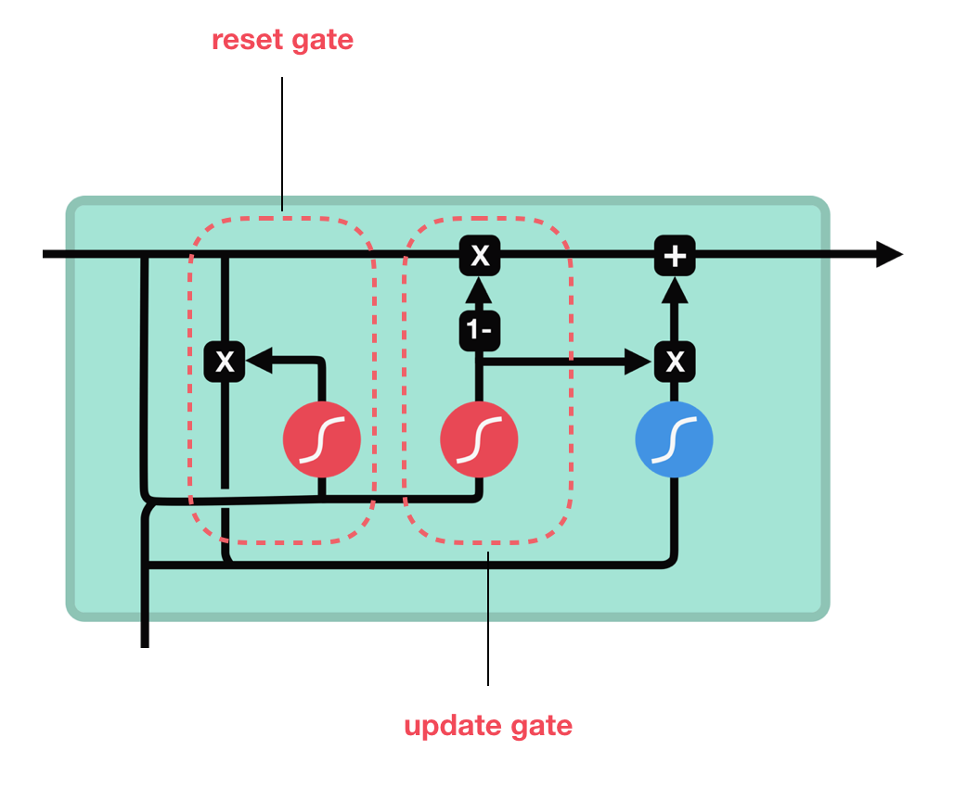
Music Recommendation Based on Human Motion
What is GRU

Slide 44
Music Recommendation Based on Human Motion
Why LSTM-GRU over LSTM-AE
Model Complexity and Training Time: LSTM-GRU models typically have fewer parameters than LSTM-AE. This is because LSTM-GRU uses gating mechanisms to control the flow of information, thereby reducing the need for large network structures. In contrast, LSTM-AE usually requires more parameters due to the two-stage (encoding and decoding) process. Thus, LSTM-GRU models require less computational resources and shorter training times compared to LSTM-AE.
Learning Long-term Dependencies: LSTM-GRU architectures be more effective at learning long-term dependencies in the data. This could potentially be beneficial if the patterns in the human motion data that are relevant for music recommendation span long time periods. In comparison, while LSTM-AE can also learn to represent long-term dependencies, they may sometimes struggle with very long sequences.

Slide 45
Music Recommendation Based on Human Motion
Why LSTM-GRU over LSTM-AE
Interpretability: LSTM-GRU models may offer better interpretability compared to LSTM-AE. Since LSTM-GRU directly models the relationship between the input sequences (human motion data) and the output (music recommendation), it can be easier to understand how the model is making its decisions. In contrast, LSTM-AE first compresses the input into a lower-dimensional representation, and this encoding-decoding process might make it harder to interpret the model's decisions.
Versatility: LSTM-GRU models can be extended to bidirectional variants (BiGRU) or can be stacked to form deeper networks more straightforwardly than LSTM-AE models. This flexibility could be advantageous if you need to experiment with more complex models to improve performance.

Slide 46
Music Recommendation Based on Human Motion
LSTM-GRU
To improve the accuracy and robustness of our dance prediction model, we have devised a deep learning architecture combining Convolutional Neural Networks (CNN) with Long Short-Term Memory (LSTM) and Gated Recurrent Unit (GRU) layers.
Key Model Features:
Convolutional Layers: Utilizing two Conv1D layers with 256 filters and LeakyReLU activation functions, we effectively capture temporal patterns in the input skeletal data.
Batch Normalization: Implemented after each Conv1D layer, Batch Normalization stabilizes training by normalizing the layer's output and mitigating internal covariate shift.
MaxPooling: Employing MaxPooling1D after the first Conv1D layer helps down-sample the data, reducing computational complexity and improving the model's efficiency.

Slide 47
Music Recommendation Based on Human Motion
LSTM-GRU
LSTM and GRU Layers: The model includes LSTM and GRU layers with 256 units each, enabling the network to learn sequential dependencies and capture long-term patterns in the dance data.
Dropout: To prevent overfitting, we introduce dropout layers after specific components of the model, randomly deactivating neurons during training.
Dense Layers: Two Dense layers with 256 units each, along with LeakyReLU activation functions, further enhance the model's ability to extract meaningful features.
Regularization: We apply L2 regularization with a coefficient of 0.001 to combat overfitting and improve generalization.

Slide 48
Music Recommendation Based on Human Motion
LSTM-GRU
Model Training:
The model is trained using the RMSprop optimizer with a learning rate of 0.001 and sparse categorical cross-entropy loss. We conduct 200 epochs of training, leveraging X_train and y_train datasets, while validating the model's performance using X_validation and y_validation datasets.
By combining these powerful architectural elements and employing regularization techniques, our enhanced dance prediction model is poised to deliver accurate and reliable predictions for various dance forms.

Slide 49
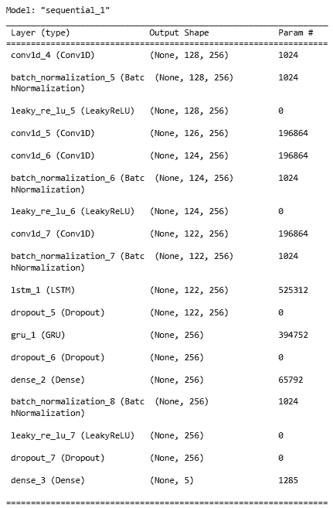
Music Recommendation Based on Human Motion
LSTM-GRU

Slide 50
Music Recommendation Based on Human Motion
Why use bidirectional?
Learning from the Past and the Future: The key advantage of bidirectional RNNs (like BiLSTM or BiGRU) is that they process the input data in both directions (forward and backward), allowing them to capture patterns from the future context as well as the past. For certain tasks such as language modeling or sequence labeling, this is a huge advantage. For our music recommendation system, it is beneficial if future motion data can help in predicting the current music recommendation.
More Context: The primary advantage of bidirectional LSTMs/GRUs is that the signal from the beginning of the input doesn't need to be processed all the way through every timestep to affect the output because we have a backward layer. This is critical for tasks where context from both the past and future are important in making a decision at the current time step.
Long sequences: They work well when the complete sequence is available at the time of prediction or when working with very long sequences where the signal from the initial steps may have vanished by the time it reaches the end of the sequence.

Slide 51
Music Recommendation Based on Human Motion
LSTM-biGRU
Our deep learning dance prediction model is designed to accurately classify dance forms from given input sequences. The model architecture comprises several layers, combining Convolutional Neural Networks (CNN), Long Short-Term Memory (LSTM), and Gated Recurrent Unit (GRU) units.
Key Model Features:
1. Convolutional Layers: The model starts with two Conv1D layers, each having 256 filters, with LeakyReLU activation to capture temporal patterns in the input data.
2. MaxPooling: After the first Conv1D layer, we introduce MaxPooling1D to down-sample the data, enhancing computational efficiency.

Slide 52
Music Recommendation Based on Human Motion
LSTM-biGRU
3. LSTM Layer: The model employs an LSTM layer with 256 units and return_sequences=True, allowing it to retain sequential information throughout the process.
4. Bidirectional GRU: The Bidirectional(GRU) layer effectively learns bidirectional dependencies within the data, further improving prediction accuracy.
5. Dense Layers: Two Dense layers with 256 units each, and LeakyReLU activation functions, facilitate feature extraction and representation.
6. Dropout: We incorporate Dropout layers after specific components to mitigate overfitting and enhance generalization capabilities.

Slide 53
Music Recommendation Based on Human Motion
LSTM-biGRU
7. Model Compilation: The model is compiled using the RMSprop optimizer with a learning rate of 0.001 and sparse categorical cross-entropy loss function.
8. Model Training: The model is trained on the training dataset (X_train, y_train) for 200 epochs, with a validation split on X_validation and y_validation.
Our comprehensive deep learning approach, combining CNN, LSTM, and GRU layers, allows our dance prediction model to accurately identify and classify various dance forms. Through extensive training and optimization, we aim to deliver a robust and reliable dance prediction system for a diverse range of dance performances.

Slide 54
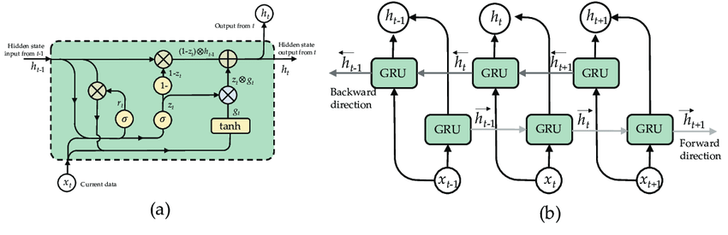
Music Recommendation Based on Human Motion
biGRU

Slide 55
Music Recommendation Based on Human Motion
biLSTM-biGRU
Our state-of-the-art deep learning dance prediction model incorporates Convolutional Neural Networks (CNN) and Recurrent Neural Networks (RNN) to accurately classify dance forms. The architecture includes Conv1D layers for feature extraction, followed by Bidirectional LSTM and Bidirectional GRU units for capturing temporal dependencies.
Key Model Features:
1. Conv1D Layers: We use multiple Conv1D layers, each with 256 filters, to extract essential features from the input data. LeakyReLU activation functions promote non-linearity.

Slide 56
Music Recommendation Based on Human Motion
biLSTM-biGRU
2. MaxPooling: After the first Conv1D layer, MaxPooling1D is applied to down-sample the data, enhancing model efficiency and reducing computation.
3. LSTM and GRU Units: Bidirectional LSTM and GRU layers with 256 units each enable the model to understand both past and future context, improving the dance form prediction.
4. Dense Layers: Dense layers with 256 units, along with LeakyReLU activation functions, facilitate feature refinement and representation.
5. Dropout: We introduce Dropout layers at various stages to prevent overfitting, ensuring the model's ability to generalize well on unseen data.

Slide 57
Music Recommendation Based on Human Motion
biLSTM-biGRU
6. Model Compilation: The model is compiled with RMSprop optimizer and uses sparse categorical cross-entropy loss to cater to the multi-class classification task.
7. Model Training: Our model is trained for 200 epochs using the training dataset (X_train, y_train), with validation on X_validation and y_validation.
Through this advanced deep learning architecture, we aim to deliver a robust and accurate dance prediction system capable of recognizing diverse dance forms with high precision and efficiency.

Slide 58
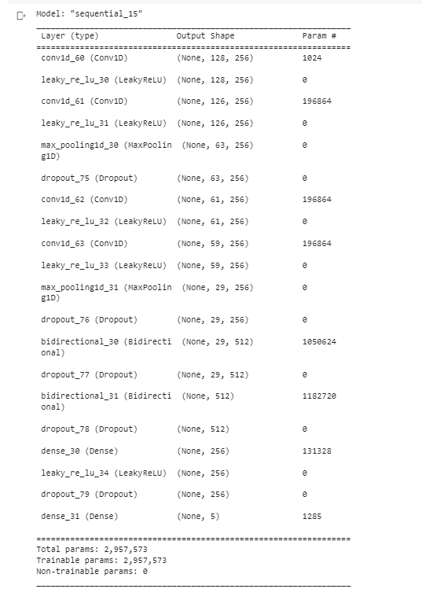
Music Recommendation Based on Human Motion
Model Summary:

Slide 59
Music Recommendation Based on Human Motion
Statistics given by these models
Model Name | Test Accuracy | F1 Score | Sparse Categorical Loss
LSTM | 0.333 | 0.5 | 6.154
LSTM-AE | 0.4484 | 0.65 | 2.0911
LSTM-GRU | 0.5 | 0.5 | 5.63
LSTM-biGRU | 0.6667 | 0.667 | 3.37
biLSTM-biGRU | 0.833 | 0.98 | 0.32

Slide 60
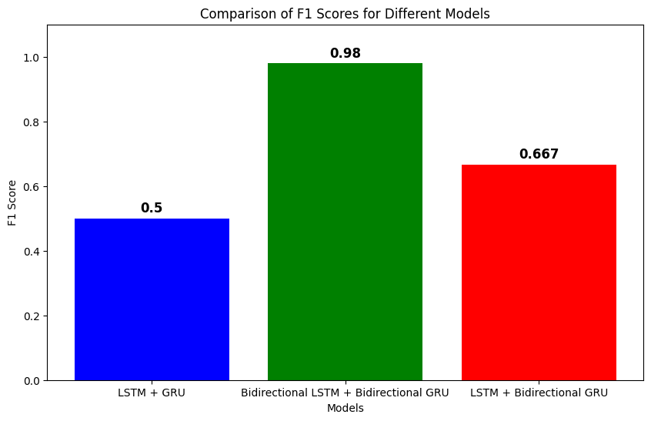
Music Recommendation Based on Human Motion
Comparisons - F1 Score

Slide 61
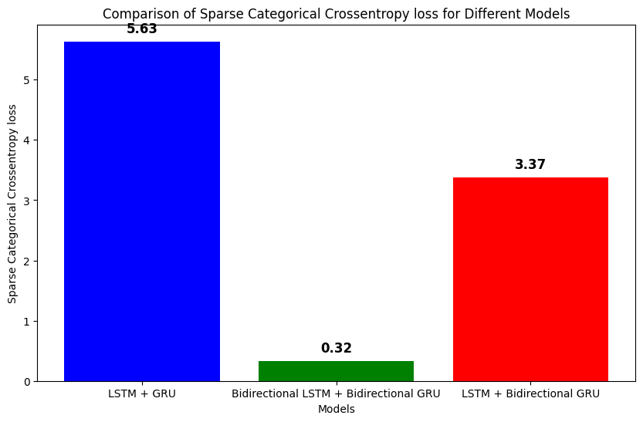
Music Recommendation Based on Human Motion
Comparisons - Sparse Categorical Loss

Slide 62
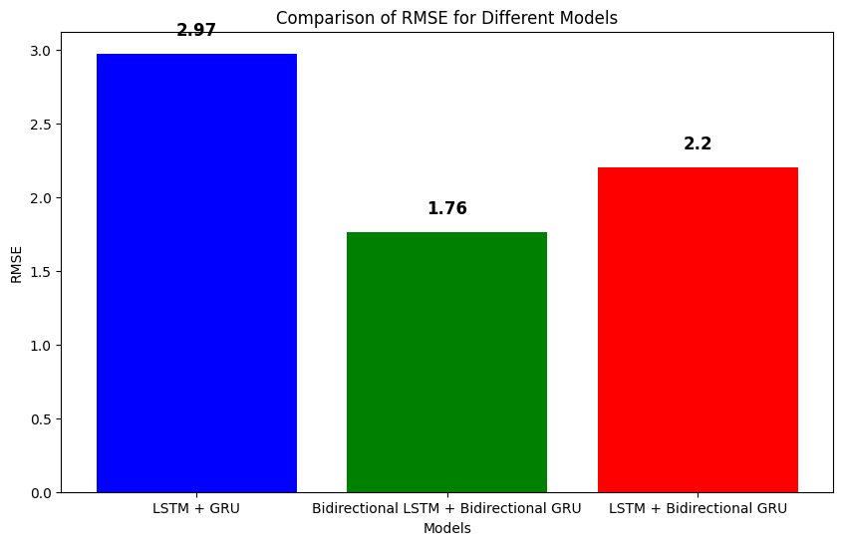
Music Recommendation Based on Human Motion
Comparisons - RMSE

Slide 63
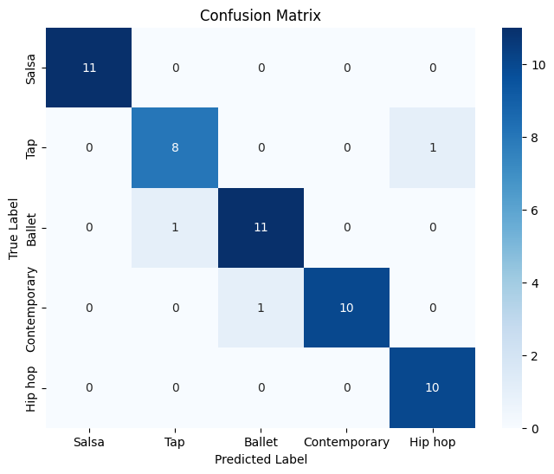
Music Recommendation Based on Human Motion
Comparisons - Confusion Matrix

Slide 64
Music Recommendation Based on Human Motion
Benefits of Combining LSTM and GRU
When comparing various deep learning models for sequential data and time-series problems, combining Long Short-Term Memory (LSTM) and Gated Recurrent Unit (GRU) in a neural network can offer several advantages:
1. Enhanced Model Capacity: LSTM and GRU are both powerful architectures that address the vanishing gradient problem in traditional RNNs. By combining them, the model gains access to different gating mechanisms and memory cells, increasing its capacity to learn complex sequential patterns.
2. Improved Generalization: LSTM and GRU have slightly different internal structures, capturing different types of dependencies in the data. The combination allows the model to learn diverse representations, promoting better generalization and avoiding overfitting.

Slide 65
Music Recommendation Based on Human Motion
Benefits of Combining LSTM and GRU
3. Faster Training: GRU's simpler architecture makes it computationally less expensive compared to LSTM. Integrating both architectures enables the model to benefit from the faster training speed of GRU while leveraging LSTM's powerful memory properties.
4. Flexibility in Model Design: Different architectures may excel at different segments of the input sequence. By using both LSTM and GRU, the model gains flexibility in choosing the architecture that suits each part of the input data best.
5. Handling Long-Term Dependencies: LSTM is renowned for handling long-term dependencies, crucial for tasks with complex relationships between sequence elements. Combining it with GRU, which is also effective in capturing dependencies but with fewer parameters, strikes a balance between model complexity and performance.

Slide 66
Music Recommendation Based on Human Motion
Benefits of Combining LSTM and GRU
6. Ensemble Effect: The combination of LSTM and GRU creates an ensemble effect, leveraging the strengths of both architectures. This can lead to improved performance and robustness in handling sequential data.
7. Better Parameter Sharing: Using LSTM and GRU in the same model enables better parameter sharing across the network. This results in more efficient use of data and a more robust representation learning process.
While combining LSTM and GRU has numerous advantages, it's important to note that this may increase the model's complexity and require more training data. Careful hyperparameter tuning and model evaluation on a validation set are crucial to ensure that the combined architecture indeed provides improvements over using LSTM or GRU individually.

Slide 67
Music Recommendation Based on Human Motion
Dance form prediction
After carefully evaluating the performance of different models, we found that the bidirectional LSTM-bidirectional GRU architecture yielded the highest accuracy for predicting dance forms. Leveraging this successful foundation, we further enhanced the model to incorporate music recommendation capabilities. By building upon this robust architecture, we aimed to offer personalized music recommendations that complement the predicted dance forms, enhancing the overall user experience.
While the bidirectional LSTM-bidirectional GRU architecture showed the highest accuracy among the tested models, we recognized that its performance was still not meeting our expectations. After careful analysis, we identified the limited size of our dataset as a contributing factor to this limitation. To address this issue, we made a strategic decision to significantly increase the size of our dataset by more than doubling its existing content.

Slide 68
Music Recommendation Based on Human Motion
Dance form prediction
Upon completion of this task, we observed a remarkable improvement in the accuracy of the dance prediction model. The larger and more diverse dataset allowed the model to learn more effectively and generalize better to different dance forms, leading to more reliable and precise predictions. This step was instrumental in elevating the overall performance of our dance prediction system and brought us closer to achieving our desired level of accuracy.

Slide 69
Music Recommendation Based on Human Motion
Recommending music
Following our decision to proceed with the bidirectional LSTM-bidirectional GRU architecture for the dance prediction model, we focused on expanding its capabilities to encompass music recommendation. By extending the existing codebase, we enabled the system to make informed music recommendations based on the identified dance form from our comprehensive database.
With this enhancement, users can now receive music suggestions that perfectly complement the dance style showcased in the input video. The integration of music recommendation functionality not only enhances the overall user experience but also aligns our system with the vision of providing a comprehensive and immersive dance and music exploration platform. This collaborative approach between dance prediction and music recommendation contributes to creating a holistic and engaging experience for our users.

Slide 70
Music Recommendation Based on Human Motion
Recommending music
The input data consists of features extracted from the songs, and the main steps of the recommendation process are as follows:
Calculate Similarity: The similarity function takes two feature vectors (arr1 and arr2) as input and computes their cosine similarity. It first calculates the dot product between the two vectors and then normalizes them using their Euclidean norms. The cosine similarity is then computed as the dot product divided by the product of the vector norms.
Create Similarity Matrix: The code initializes an empty matrix called similarities with dimensions (n_samples, n_samples), where n_samples is the number of songs in the dataset. It then iterates through each pair of songs and calculates their similarity using the similarity function. The resulting similarity scores are stored in the similarities matrix.

Slide 71
Music Recommendation Based on Human Motion
Recommending music
Exclude Diagonal Entries: Since the diagonal entries of the similarity matrix represent the similarity of each song with itself, they are set to 0 to avoid self-recommendations.
Song Recommendations: The code compiles a list of song names from the input dataset. It then prints the song recommendations in a formatted manner, where each row displays two song names, with the song on the left recommended for the song on the right based on their computed similarity scores.
The output of the code provides a list of song pairs, where each pair consists of two songs, and the first song is recommended to the second song based on their similarity. This recommendation system leverages cosine similarity to suggest related songs and can be useful for generating personalized music recommendations for users.

Slide 72
Music Recommendation Based on Human Motion
Recommending music
Cosine similarity is a metric used to measure the similarity between two non-zero vectors in an n-dimensional space. It quantifies the cosine of the angle between the vectors, representing the directional similarity rather than the magnitude similarity.
Cosine Similarity(A, B) = (A . B) / (||A|| * ||B||)
Cosine similarity is a particularly useful metric when dealing with high-dimensional data or sparse data, such as in text documents represented as term-frequency vectors. It allows us to measure the similarity between documents based on the angles between the vectors, irrespective of their magnitudes.

Slide 73
Music Recommendation Based on Human Motion
Recommending music
In recommendation systems, cosine similarity is commonly used to find similar items or content by representing items and users as feature vectors. By calculating the cosine similarity between these vectors, the system can suggest similar items or predict user preferences based on similar users' behaviors.

Slide 74
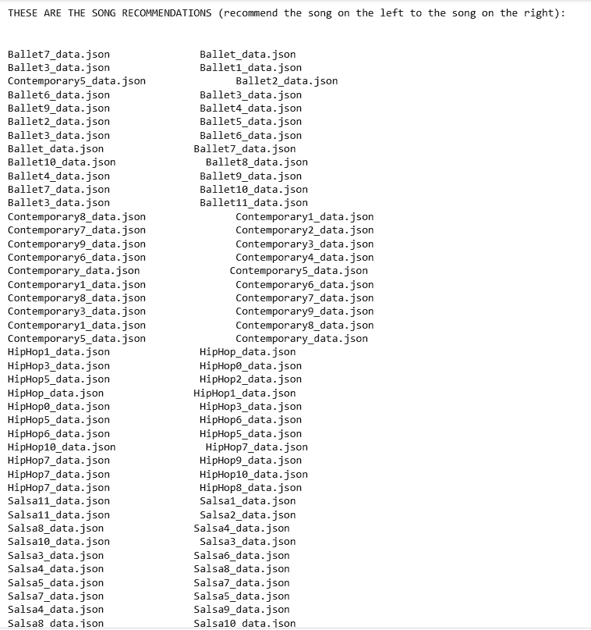
Music Recommendation Based on Human Motion

Slide 75
Music Recommendation Based on Human Motion
Applications/Use cases
Dance Practice and Training
Dance Performances: Choreographers and dance troupes can benefit from the system by selecting music that enhances their performances.
Dance Competitions: participants can use the system to receive music recommendations based on their chosen dance styles.
Dance Education and Workshops: Dance instructors can incorporate the system into their teaching curriculum to introduce students to various dance styles and provide them with relevant music examples.
Personal enjoyment

Slide 76
Music Recommendation Based on Human Motion
Milestones
1. Improved Music Recommendation: We aim to enhance the accuracy of music recommendations by leveraging better resources and accessing larger, more accurate datasets. This step will enable us to provide users with music suggestions that perfectly align with the identified dance form.
2. Real-time Video Support: Our next milestone involves extending the project's capabilities to handle real-time videos. By enabling the model to predict dance forms and recommend music in real-time, we aim to create a more dynamic and interactive user experience.
3. Research Paper Publication: We plan to publish a comprehensive research paper detailing all the significant progress and findings achieved throughout our project. This paper will provide in-depth insights into the development of our dance prediction and music recommendation system, and it will contribute valuable knowledge to the research community.
These milestones represent the key objectives we intend to achieve, showcasing our dedication to continual improvement and innovation in the realm of dance prediction and music recommendation technology.

Slide 77
Music Recommendation Based on Human Motion
References
[1] Wenjuan Gong and QingShuang Yu, “A Deep Music Recommendation Method Based on Human Motion Analysis”
A Deep Music Recommendation Method Based on Human Motion Analysis | IEEE Journals & Magazine | IEEE Xplore
[2] Yu Qi, Yazhou Liu and Quansen Sun, “Music-Driven Dance Generation”
Music-Driven Dance Generation | IEEE Journals & Magazine | IEEE Xplore
[3] Hsin-Ying Lee, Xiaodong Yang, Ming-Yu Liu, Ting-Chun Wang, “Dancing to Music”
[1911.02001] Dancing to Music (arxiv.org)

Slide 78
Thank You

